Slide 1




Title I Annual Meeting
Palm Bay Academy – September 1, 2022

Slide 2
Purpose of Meeting
According to the Every Student Succeeds Act (ESSA), schools are required to host an Annual Meeting to explain and discuss:
Title I programs and requirements
    Parent and Family Engagement Plan
    School-Parent Compact
    Parents’ Right to Know
    Design, Implement and Evaluate School Improvement
    Plan (SIP/SWP) Goals
    Gather Stakeholder Input
Additional support
    School and Family Partnerships
    Business Partnerships

Slide 3
What is Title I?
Title I is a federal grant that:
Ensures all children have the opportunity to obtain a high-quality education and reach proficiency on challenging state academic standards and assessments
provides supplemental funds to school districts to assist schools with high concentrations of poverty to meet educational goals
assists with building capacity of parents and teachers
encourages parents to be involved in their children’s education

Slide 4
Title I Funding
Districts allocate Title I funds to qualifying schools based on the number of students eligible to receive free/reduced price meals
Title I must supplement, not supplant district funds
A specified amount of the Title I grant must be spent on family engagement and professional development
Parents have the right to give input regarding how the school will use its Title I funds

Slide 5
Who decides how funds are used?
Your administrative team considers data and feedback collected throughout the school year to build their school budget
Every school has a School Advisory Council (SAC) composed of:
  parents, teachers, staff, community members, principal and students (at middle and high schools)
The School Advisory Council helps determine how to use Title I funds. Please consider joining!
Use of Title I funds must align with the goals of the School Improvement Plan (SIP) and School-wide Plan (SWP) for Title I
  Copies of these documents are available for review in the school office (translated, when possible)

Slide 6
Title I Programs
All Title I public schools in Brevard are school-wide programs, meaning Title I funds, along with other local-, state- and federal funding sources are used to support all students in the school
The primary focus of the Title I program is to support the students most at-risk for academic failure

Slide 7
Use of Title I Funds
Palm Bay Academy is provided with $211,552 to pay for services and programs for our students.
School-based Title I funds pay for the following:
  Parent Engagement Programs
  Intervention Teachers
  Intervention Teacher’s Aides
  Reading Coach
  Educational Programs such as I-Ready

Slide 8
School Grade Information
Palm Bay Academy’s school grade this past year was a C. Our reading and math scores from the past three years have been lower than we would like them to be. We have worked hard to create an action plan that will allow us to improve these scores and accelerate student learning. This includes a deep analysis of the previous years FSA scores and data trends to help identify which content areas need the most work.

Slide 9
SIP/SWP Goals
How we Use Title I funds to support SIP and SWP goals
A large portion of our Title I funds are used to hire personnel. We currently have three interventionists Ms. Orellana, Ms. McClendon, and Mrs. Houlihan. Interventionists work to help students bridge the gap in math and reading. We are currently seeking a Reading Coach.
We want to improve our student's scientific ability as well and to do this we purchased STEM kits and have created a science lab that all classes visit for an hour each week to practice hands-on science.
We hope to increase positive behaviors in our school by continuing to use the Leader in Me program and have loved what we have seen so far. Students and teachers are infusing the 7 Habits into their school day and hopefully their homelives as well!

Slide 10
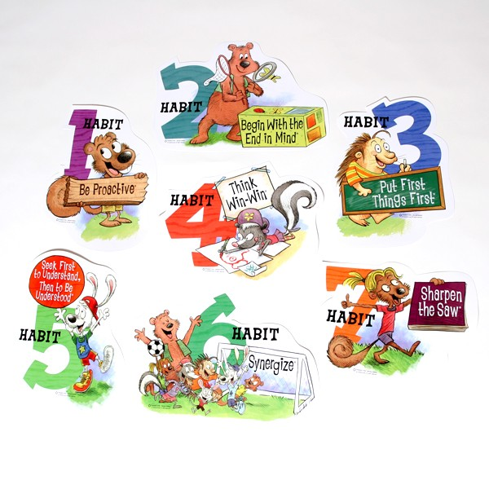
7 Habits of the Leader in Me…

Slide 11
Educational Standards
Florida’s academic content standards establish high expectations for all students in the areas of reading, mathematics, writing, and science
Florida Standards for Language Arts and Math identify what your child needs to know and be able to do. Information can be found at:
  https://www.cpalms.org

Slide 12
Testing
Parents are to be provided information regarding the level of achievement of their child on each state academic assessment required by law. Test results for the 2021-22 school year will be going home in backpacks on Friday, September 2 (tomorrow!), so keep an eye out for these!
To the extent that is feasible, testing information must be translated into a language the parents can understand

Slide 13
Testing
3rd – 8th graders take the Florida Standards Assessment (FSA) every spring. Scores range from 1 to 5, and 3 is considered passing. Students in 5th and 8th grade also take State Science Assessments.
Students are tested periodically throughout the year with district-wide assessments (iReady, FAST, Renaissance/STAR, and more) to ensure they are meeting district-wide benchmarks.
Please attend our upcoming Open House (September 14, 5:00-7:00 PM) to learn more about the curriculum and standard expectations specific to your grade level.

Slide 14
Parent and Family Engagement Plan (PFEP)
Each Title I school must jointly develop, agree upon, and distribute to parents a written Parent and Family Engagement Plan (PFEP)
The Parent and Family Engagement Plan (PFEP) describes how the school will carry out parent involvement requirements, including the development of a School-Parent Compact

Slide 15
Parent and Family Engagement Plan (PFEP)
Title I schools must:
provide timely information about Title I programs to parents
explain the curriculum, assessments, and the minimum standards that students are required to meet
offer a flexible number of meeting dates and times

Slide 16
Parent and Family Engagement Plan (PFEP)
Title I schools must:
involve parents in making decisions about how Title I funds reserved for parent involvement should be spent
provide documents to show that families were given information translated in their native language, when reasonable
show evidence of continuous communication between the school, families, students, and community

Slide 17
Parent and Family Engagement Plan (PFEP)
Title I schools must:
provide information on how the school works with community, volunteers, and business partnerships to increase student achievement
provide trainings to staff and parents designed to increase student achievement and support family engagement

Slide 18
Parent and Family Engagement Plan(PFEP)
Title I schools must:
jointly conduct an annual evaluation of the content and effectiveness of the school’s Parent and Family Engagement Plan (PFEP)
monitor and evaluate the strategies of the Parent and Family Engagement Plan (PFEP)
use the findings of the evaluation to design and revise strategies for more effective family involvement

Slide 19
Parent Survey Results
Survey results showed that our parents feel that PBA has improved dramatically regarding building a community and creating a friendly environment on all campuses.
Parent Panther Leader meetings – Second Tuesday of every month from 6:00-7:00 PM – Be a part of PBA’s leadership team and practice the 7 Habits!
We communicate with parents in a variety of ways, please contact your teachers if you have any concerns and I am always willing to help!
Make sure the office has your most up to date contact information!
Attend our monthly Family Events to enjoy time with your children and teachers – Open House (Sept), Spooky Stories Trunk or Treat (Oct), Winter Math Night (Dec), Star Party (Feb), Seussabration (March), Earth Day Beach Clean Up (April), Book Tasting (May)

Slide 20
Title I Complaint Procedure
Parents have the right to submit comments regarding district and/or school Title I plans
  Comments should be turned in to the school
  The school will forward comments to the district Office of Title I
  The district Office of Title I will include parent comments when plans are submitted to the Florida Department of Education

Slide 21
School-Parent Compact
Each school must have a School-Parent Compact that is written by parents and school personnel
The compact outlines the responsibilities of the students, parents, and school staff in striving to raise student achievement
The compact will be shared during parent-teacher conferences throughout the year
The compact is to be reviewed each year by the parent, student, and teacher

Slide 22

Parents’ Right to Know
Parents have the right to request and receive timely information regarding the professional qualifications of their child’s teachers and paraprofessionals
Parents must be notified if their child is assigned to or taught for four or more consecutive weeks by a teacher who is not state certified

Slide 23
Research shows…
(Epstein and Associates, 2009)
No matter the socio-economic status, when parents are involved, students are more likely to:
  attend school regularly
  earn better grades
  obtain better test scores
  pass courses
  be promoted to the next grade
  adapt to change
  have better social skills
  graduate
  continue their education

Slide 24
Tips for Success:
Communicate with your child’s teacher often throughout the year!
Make attendance, punctuality, homework, and reading priorities.
Attend PBA Family Events and teacher conferences.
Consider joining the School Advisory Council (SAC), the Title I District Advisory Council, or being a Parent Panther Leader. Let your voice be heard.
Reach out to Nina Orellana (korellana@palmbayacademy.org) or Michelle Allred (mallred@palmbayacademy.org) at 321-984-2710 with questions or concerns.
Notes:
Discuss your parent resource room, what is offered, and what is available.

Slide 25
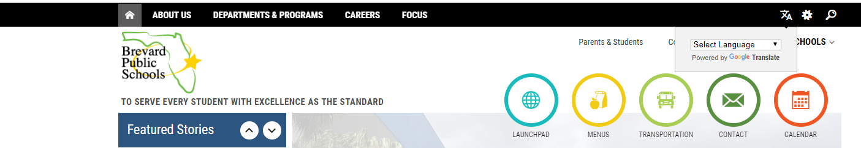
Tips for Success:
https://www.palmbayacademy.org/
About us, Leader in Me, Campuses, Services, Students, Parents, Information, Newsletter, Contact and Calendar
Also, Brevardschools.org has a Google Translate function!

Slide 26
Tips for Success:
Don’t forget to sign up for your FOCUS account. Monitor your child’s grades and stay in touch with their teacher! See Ms. Linda at the front desk if you need access information.
Please consider volunteering in your child’s classroom this year! We’d love to have you!
Please complete the Annual Meeting Feedback form. Your opinions matter to us!

Slide 27
Important Sources of Information
Brevard School District Website: www.brevardschools.org
Palm Bay Academy Website: www.palmbayacademy.org
Palm Bay Academy: (321) 984-2710
Nina Orellana, Title 1 and MTSS Coordinator: korellana@palmbayacademy.org
Please contact me if you have questions, suggestions, or input!

Slide 28
Important Upcoming Events!
First Parent Panther Leader Meeting – Thursday, September 8, 2022 at 6:00 PM (and the second Thursday of every month!)
Open House and Book Fair – Wednesday, September 14, 2022 at 5:30 PM
1st Quarter Parent Conferences – Tuesday, November 1, 2022 – call to schedule a time (or call anytime to schedule a parent-teacher conference whenever you would like one!)

